Slide 1
IP Addressing

Slide 2
IP Addresses
Structure of an IP address
Classful IP addresses
Limitations and problems with classful IP addresses
Subnetting
CIDR
IP Version 6 addresses

Slide 3
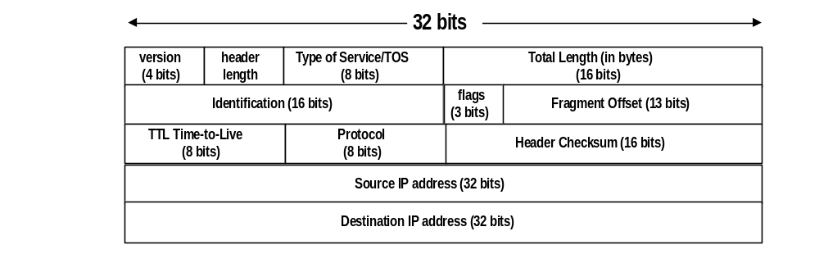
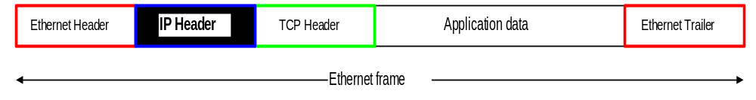
IP Addresses

Slide 4
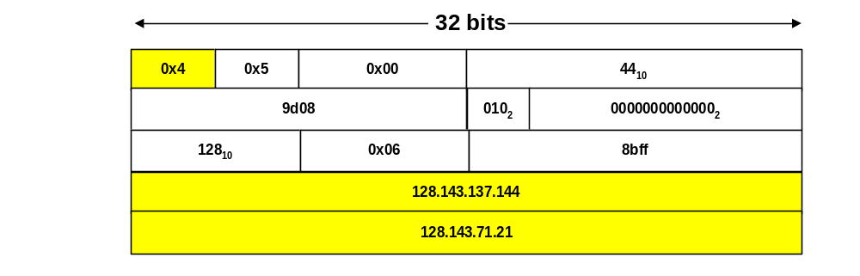
IP Addresses

Slide 5
What is an IP Address?
An IP address is a unique global address for a network interface
Exceptions:
  Dynamically assigned IP addresses (→ DHCP, Lab 7)
  IP addresses in private networks (→ NAT, Lab 7)
An IP address:
- is a 32 bit long identifier
- encodes a network number (network prefix)
and a host number

Slide 6
Network prefix and host number
The network prefix identifies a network and the host number identifies a specific host (actually, interface on the network).
How do we know how long the network prefix is?
  Before 1993: The network prefix is implicitly defined (see class-based addressing)
  or
  After 1993: The network prefix is indicated by a netmask.
network prefix
host number

Slide 7
Dotted Decimal Notation
IP addresses are written in a so-called dotted decimal notation
Each byte is identified by a decimal number in the range [0..255]:
Example:
10000000
10001111
10001001
10010000
1st Byte
= 128
2nd Byte
= 143
3rd Byte
= 137
4th Byte
= 144
128.143.137.144

Slide 8
Example
Example: ellington.cs.virginia.edu
Network address is: 128.143.0.0 (or 128.143)
Host number is: 137.144
Netmask is: 255.255.0.0 (or ffff0000)
Prefix or CIDR notation: 128.143.137.144/16
        Network prefix is 16 bits long
128.143
137.144

Slide 9
Special IP Addresses
Reserved or (by convention) special addresses:
  Loopback interfaces
      all addresses 127.0.0.1-127.255.255.255 are reserved for loopback interfaces
      Most systems use 127.0.0.1 as loopback address
      loopback interface is associated with name “localhost”
  IP address of a network
      Host number is set to all zeros, e.g., 128.143.0.0
  Broadcast address
      Host number is all ones, e.g., 128.143.255.255
      Broadcast goes to all hosts on the network
      Often ignored due to security concerns
Test / Experimental addresses
Certain address ranges are reserved for “experimental use”. Packets should get dropped if they contain this destination address (see RFC 1918):
  10.0.0.0 - 10.255.255.255
  172.16.0.0 - 172.31.255.255
  192.168.0.0 - 192.168.255.255
Convention (but not a reserved address)
  Default gateway has host number set to ‘1’, e.g., e.g., 192.0.1.1

Slide 10
Subnetting
Problem: Organizations have multiple networks which are independently managed
  Solution 1: Allocate a separate network address for each network
    Difficult to manage
    From the outside of the organization, each network must be addressable.
  Solution 2: Add another level of hierarchy to the IP addressing structure
University Network
Engineering
School
Medical
School
Library
Subnetting

Slide 11
Address assignment with subnetting
Each part of the organization is allocated a range of IP addresses (subnets or subnetworks)
Addresses in each subnet can be administered locally
University Network
128.143.0.0/16
Engineering
School
Medical
School
128.143.71.0/24
128.143.136.0/24
128.143.56.0/24
Library
128.143.121.0/24

Slide 12
Basic Idea of Subnetting
Split the host number portion of an IP address into a subnet number and a (smaller) host number.
Result is a 3-layer hierarchy
Then:
    Subnets can be freely assigned within the organization
    Internally, subnets are treated as separate networks
    Subnet structure is not visible outside the organization
network prefix
host number
network prefix
subnet number
host number
extended network prefix

Slide 13
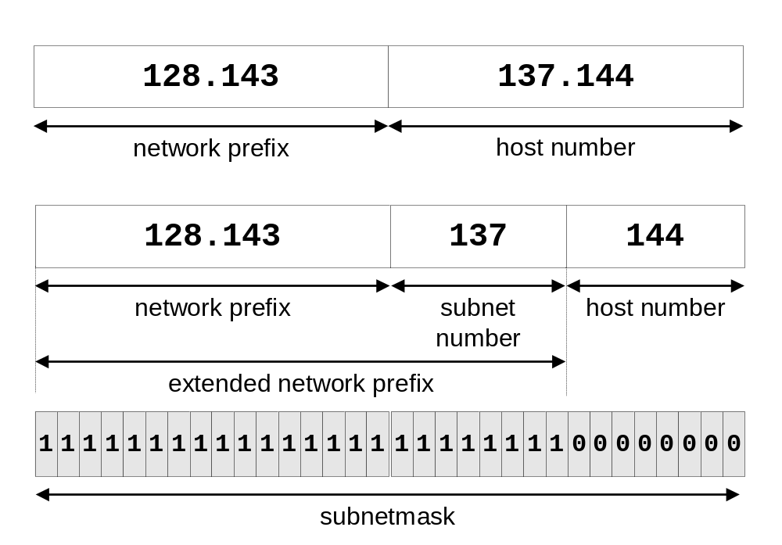
Subnetmask
Routers and hosts use an extended network prefix (subnetmask) to identify the start of the host numbers

Slide 14
Advantages of Subnetting
With subnetting, IP addresses use a 3-layer hierarchy:
        Network
        Subnet
        Host
Reduces router complexity. Since external routers do not know about subnetting, the complexity of routing tables at external routers is reduced.
Note: Length of the subnet mask need not be identical at all subnetworks.

Slide 15
Example: Subnetmask
128.143.0.0/16 is the IP address of the network
128.143.137.0/24 is the IP address of the subnet
128.143.137.144 is the IP address of the host
255.255.255.0 (or ffffff00) is the subnetmask of the host
When subnetting is used, one generally speaks of a “subnetmask” (instead of a netmask) and a “subnet” (instead of a network)
Use of subnetting or length of the subnetmask if decided by the network administrator
Consistency of subnetmasks is responsibility of administrator

Slide 16
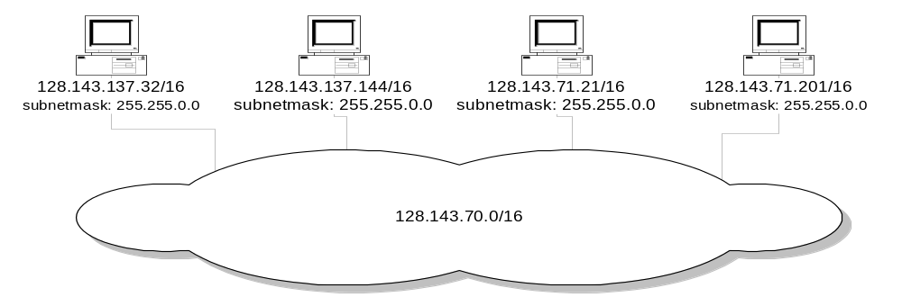
No Subnetting
All hosts think that the other hosts are on the same network

Slide 17
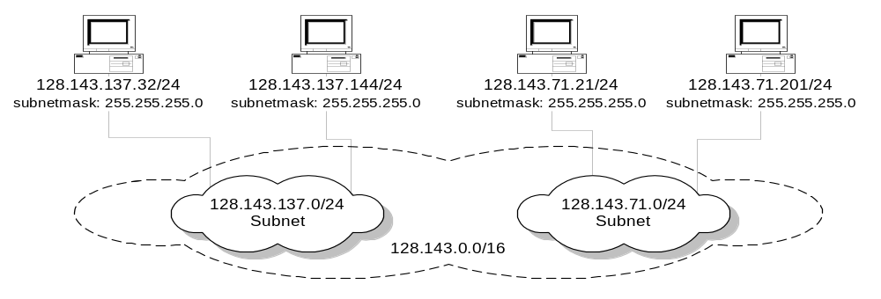
With Subnetting
Hosts with same extended network prefix belong to the same network

Slide 18
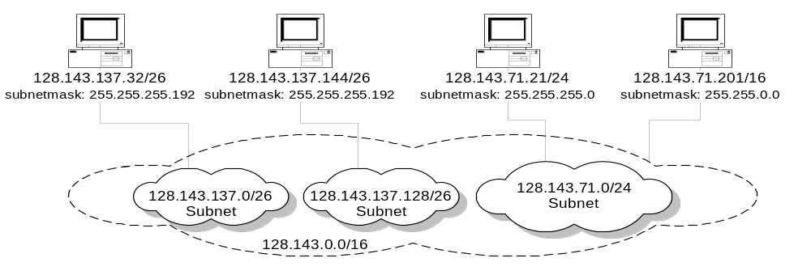
With Subnetting
Different subnetmasks lead to different views of the size of the scope of the network

Slide 19
Classful IP Adresses (Until 1993)
When Internet addresses were standardized (early 1980s), the Internet address space was divided up into classes:
  Class A: Network prefix is 8 bits long
  Class B: Network prefix is 16 bits long
  Class C: Network prefix is 24 bits long
Each IP address contained a key which identifies the class:
  Class A: IP address starts with “0”
  Class B: IP address starts with “10”
  Class C: IP address starts with “110”

Slide 20
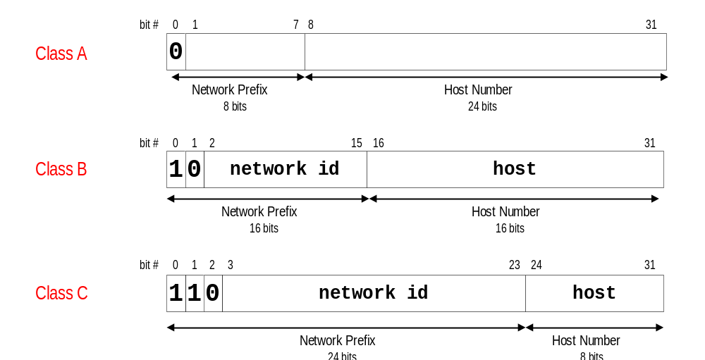
The old way: Internet Address Classes

Slide 21
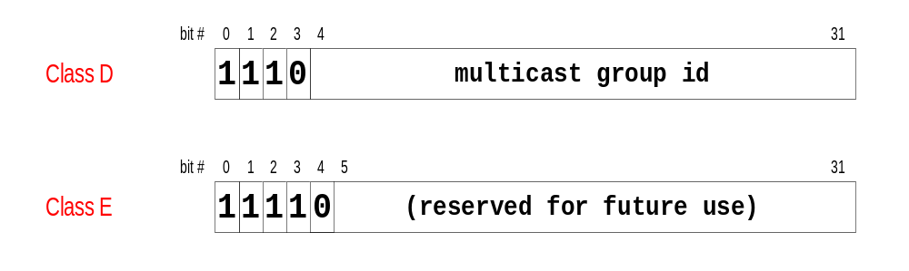
The old way: Internet Address Classes
We will learn about multicast addresses later in this course.

Slide 22
Problems with Classful IP Addresses
By the early 1990s, the original classful address scheme had a number of problems
  Flat address space. Routing tables on the backbone Internet need to have an entry for each network address. When Class C networks were widely used, this created a problem. By the 1993, the size of the routing tables started to outgrow the capacity of routers.
Other problems:
  Too few network addresses for large networks
    Class A and Class B addresses were gone
  Limited flexibility for network addresses:
    Class A and B addresses are overkill (>64,000 addresses)
    Class C address is insufficient (requires 40 Class C addresses)

Slide 23
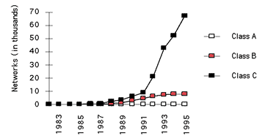
Allocation of Classful Addresses

Slide 24
CIDR - Classless Interdomain Routing
IP backbone routers have one routing table entry for each network address:
  With subnetting, a backbone router only needs to know one entry for each Class A, B, or C networks
  This is acceptable for Class A and Class B networks
    2⁷ = 128 Class A networks
    2¹⁴ = 16,384 Class B networks
  But this is not acceptable for Class C networks
    2²¹ = 2,097,152 Class C networks
In 1993, the size of the routing tables started to outgrow the capacity of routers
Consequence: The Class-based assignment of IP addresses had to be abandoned

Slide 25
CIDR - Classless Interdomain Routing
Goals:
  New interpretation of the IP address space
  Restructure IP address assignments to increase efficiency
  Permits route aggregation to minimize route table entries
CIDR (Classless Interdomain routing)
  abandons the notion of classes
  Key Concept: The length of the network prefix in the IP addresses is kept arbitrary
  Consequence: Size of the network prefix must be provided with an IP address

Slide 26
CIDR Notation
CIDR notation of an IP address:
192.0.2.0/18
    "18" is the prefix length. It states that the first 18 bits are the network prefix of the address (and 14 bits are available for specific host addresses)
CIDR notation can replace the use of subnetmasks (but is more general)
  IP address 128.143.137.144 and subnetmask 255.255.255.0 becomes 128.143.137.144/24
CIDR notation allows to drop traling zeros of network addresses:
192.0.2.0/18 can be written as 192.0.2/18

Slide 27
Why do people still talk about
CIDR eliminates the concept of class A, B, and C networks and replaces it with a network prefix
Existing classful network addresses are converted to CIDR addresses:
    128.143.0.0 → 128.143.0.0/16
The change has not affected many (previously existing) enterprise networks
  Many network administrators (especially on university campuses) have not noticed the change (and still talk about
(Note: CIDR was introduced with the role-out of BGPv4 as interdomain routing protocol. )

Slide 28
CIDR address blocks
CIDR notation can nicely express blocks of addresses
Blocks are used when allocating IP addresses for a company and for routing tables (route aggregation)
CIDR Block Prefix # of Host Addresses
/27 32
/26 64
/25 128
/24 256
/23 512
/22 1,024
/21 2,048
/20 4,096
/19 8,192
/18 16,384
/17 32,768
/16 65,536
/15 131,072
/14 262,144
/13 524,288

Slide 29
CIDR and Address assignments
Backbone ISPs obtain large block of IP addresses space and then reallocate portions of their address blocks to their customers.
Example:
Assume that an ISP owns the address block 206.0.64.0/18, which represents 16,384 (2¹⁴) IP addresses
Suppose a client requires 800 host addresses
With classful addresses: need to assign a class B address (and waste ~64,700 addresses) or four individual Class Cs (and introducing 4 new routes into the global Internet routing tables)
With CIDR: Assign a /22 block, e.g., 206.0.68.0/22, and allocated a block of 1,024 (2¹⁰) IP addresses.

Slide 30
CIDR and Routing
Aggregation of routing table entries:
  128.143.0.0/16 and 128.144.0.0/16 are represented as 128.142.0.0/15
Longest prefix match: Routing table lookup finds the routing entry that matches the longest prefix
What is the outgoing interface for
128.143.137.0/24 ?
Route aggregation can be exploited
when IP address blocks are assigned
in an hierarchical fashion
Prefix | Interface
128.0.0.0/4 | interface #5
128.128.0.0/9 | interface #2
128.143.128.0/17 | interface #1
Routing table

Slide 31
CIDR and Routing Information
Company X :
206.0.68.0/22
ISP X owns:
206.0.64.0/18
204.188.0.0/15
209.88.232.0/21
Internet Backbone
ISP y :
209.88.237.0/24
Organization z1 :
209.88.237.192/26
Organization z2 :
209.88.237.0/26

Slide 32
CIDR and Routing Information
Backbone routers do not know anything about Company X, ISP Y, or Organizations z1, z2.
Company X :
206.0.68.0/22
ISP X owns:
ISP X does not know about Organizations z1, z2.
ISP y sends everything which matches the prefix:
209.88.237.192/26 to Organizations z1
209.88.237.0/26 to Organizations z2
206.0.64.0/18
204.188.0.0/15
209.88.232.0/21
Internet Backbone
ISP X sends everything which matches the prefix: 206.0.68.0/22 to Company X,
209.88.237.0/24 to ISP y
ISP y :
209.88.237.0/24
Backbone sends everything which matches the prefixes 206.0.64.0/18, 204.188.0.0/15, 209.88.232.0/21 to ISP X.
Organization z1 :
209.88.237.192/26
Organization z2 :
209.88.237.0/26

Slide 33
IPv6 - IP Version 6
IP Version 6
  Is the successor to the currently used IPv4
  Specification completed in 1994
  Makes improvements to IPv4 (no revolutionary changes)
One (not the only !) feature of IPv6 is a significant increase in of the IP address to 128 bits (16 bytes)
    IPv6 will solve – for the foreseeable future – the problems with IP addressing
    10²⁴ addresses per square inch on the surface of the Earth.

Slide 34
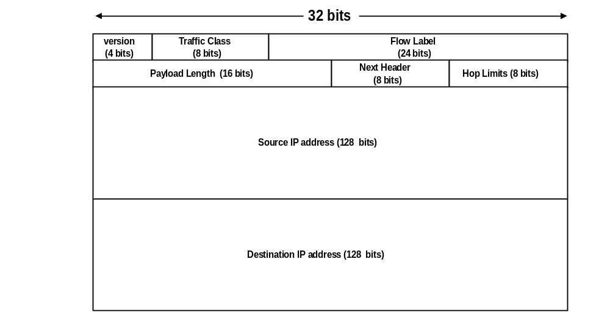
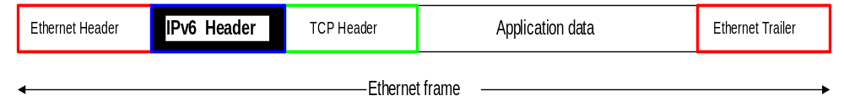
IPv6 Header

Slide 35
IPv6 vs. IPv4: Address Comparison
IPv4 has a maximum of
    2³² ≈ 4 billion addresses
IPv6 has a maximum of
  2¹²⁸ = (2³²)⁴ ≈ 4 billion x 4 billion x 4 billion x 4 billion addresses

Slide 36
Notation of IPv6 addresses
Convention: The 128-bit IPv6 address is written as eight 16-bit integers (using hexadecimal digits for each integer)
CEDF:BP76:3245:4464:FACE:2E50:3025:DF12
Short notation:
Abbreviations of leading zeroes:
CEDF:BP76:0000:0000:009E:0000:3025:DF12
→ CEDF:BP76:0:0:9E :0:3025:DF12
“:0000:0000:0000” can be written as “::”
CEDF:BP76:0:0:FACE:0:3025:DF12 → CEDF:BP76::FACE:0:3025:DF12
IPv6 addresses derived from IPv4 addresses have 96 leading zero bits. Convention allows to use IPv4 notation for the last 32 bits.
  ::80:8F:89:90 → ::128.143.137.144

Slide 37
IPv6 Provider-Based Addresses
The first IPv6 addresses will be allocated to a provider-based plan
Type: Set to “010” for provider-based addresses
Registry: identifies the agency that registered the address
The following fields have a variable length (recommeded length in “()”)
Provider: Id of Internet access provider (16 bits)
Subscriber: Id of the organization at provider (24 bits)
Subnetwork: Id of subnet within organization (32 bits)
Interface: identifies an interface at a node (48 bits)
010
Registry
ID
Provider
ID
Subscriber
ID
Subnetwork
ID
Interface
ID

Slide 38
Dynamic Routing Protocols I
RIP

Slide 39
Routing
Recall: There are two parts to routing IP packets:
1. How to pass a packet from an input interface to the output interface of a router (packet forwarding) ?
2. How to find and setup a route ?
We already discussed the packet forwarding part
There are two approaches for calculating the routing tables:
  Static Routing
  Dynamic Routing: Routes are calculated by a routing protocol

Slide 40
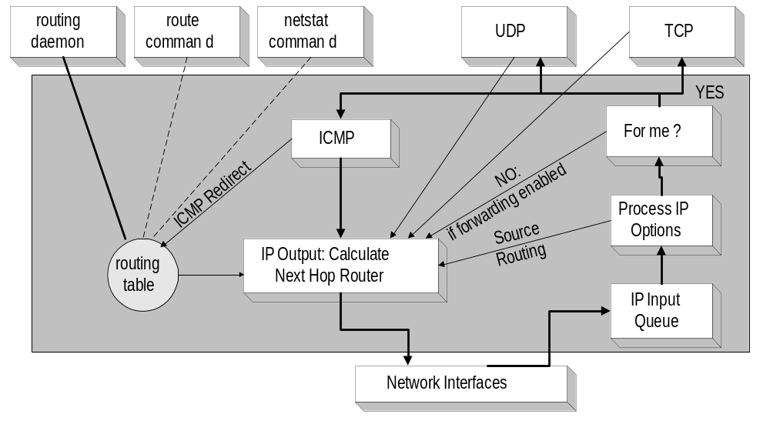
IP Routing

Slide 41
Autonomous Systems
An autonomous system is a region of the Internet that is administered by a single entity.
Examples of autonomous regions are:
    UVA’s campus network
    MCI’s backbone network
    Regional Internet Service Provider
Routing is done differently within an autonomous system (intradomain routing) and between autonomous system (interdomain routing).

Slide 42
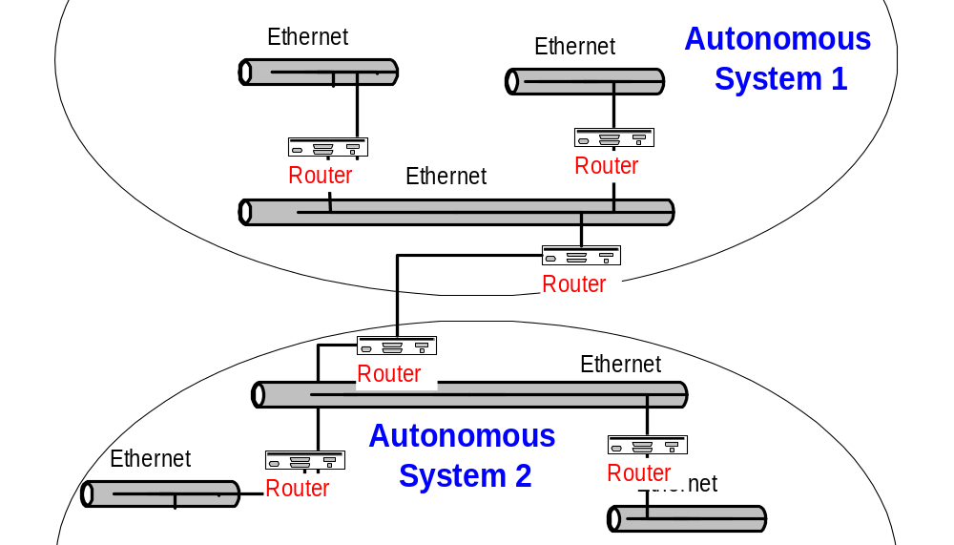
Autonomous Systems (AS)

Slide 43
Interdomain and Intradomain Routing
Intradomain Routing
Routing within an AS
Ignores the Internet outside the AS
Protocols for Intradomain routing are also called Interior Gateway Protocols or IGP’s.
Popular protocols are
  RIP (simple, old)
  OSPF (better)
Interdomain Routing
Routing between AS’s
Assumes that the Internet consists of a collection of interconnected AS’s
Normally, there is one dedicated router in each AS that handles interdomain traffic.
Protocols for interdomain routing are also called Exterior Gateway Protocols or EGP’s.
Routing protocols:
  EGP
  BGP (more recent)

Slide 44
Components of a Routing Algorithm
A procedure for sending and receiving reachability information about network to other routers
A procedure for calculating optimal routes
  Routes are calculated using a shortest path algorithm:
    Goal: Given a network were each link is assigned a cost. Find the path with the least cost between two networks with minimum cost.
A procedure for reacting to and advertising topology changes

Slide 45
Approaches to Shortest Path Routing
There are two basic routing algorithms found on the Internet.
1. Distance Vector Routing
Each node knows the distance (=cost) to its directly connected neighbors
A node sends periodically a list of routing updates to its neighbors.
If all nodes update their distances, the routing tables eventually converge
New nodes advertise themselves to their neighbors
2. Link State Routing
Each node knows the distance to its neighbors
The distance information (=link state) is broadcast to all nodes in the network
Each node calculates the routing tables independently

Slide 46
Routing Algorithms in the Internet
Distance Vector
Routing Information Protocol (RIP)
Gateway-to-Gateway Protocol (GGP)
Exterior Gateway Protocol (EGP)
Interior Gateway Routing Protocol (IGRP)
Link State
Intermediate System - Intermediate System (IS-IS)
Open Shortest Path First (OSPF)

Slide 47
Dynamic IP Routing Protocols
In Unix systems, the dynamic setting of routing tables is done by the routed or gated daemons
The routing daemons execute the following intradomain and interdomain routing protocols
intradomain
interdomain

Slide 48
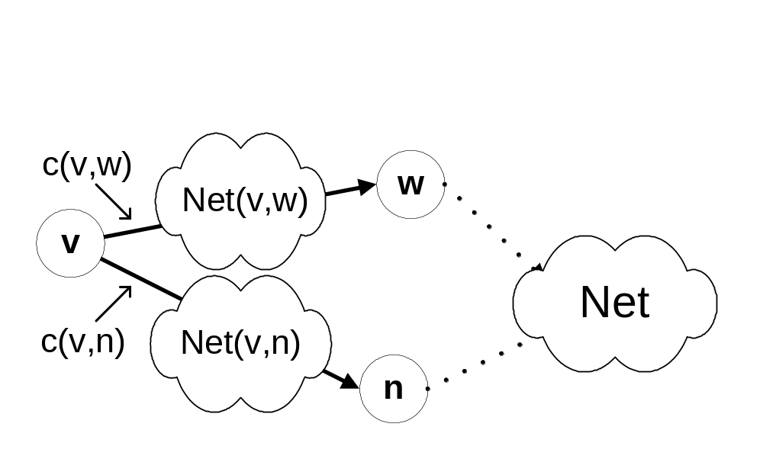
A network as a graph
In the following, networks are represented as a network graph:
  nodes are connected by networks
      network can be a link or a LAN
  network interface has cost
  networks are destinations
  Net(v,w) is an IP address of a network
For ease of notation,
we often replace the
clouds between nodes
by simple links.

Slide 49
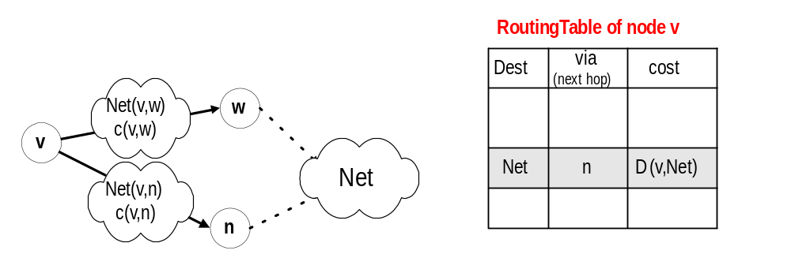
Distance Vector Algorithm: Routing Table
c(v,w): cost to transmit on the interface to network Net(v,w)
Net(v,w): Network address of the network between v and w
The network can be a link, but could also be a LAN

Slide 50
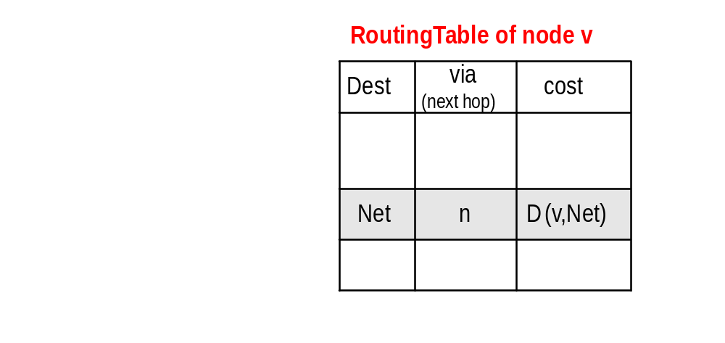
Distance Vector Algorithm: Messages
Nodes send messages to their neighbors which contain routing table entries
A message has the format: [Net , D(v,Net)] means“My cost to go to Net is D (v,Net)”
[Net , D(v,Net)]
v
n

Slide 51
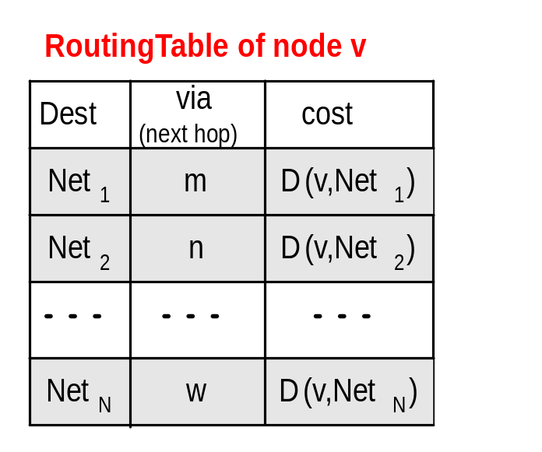
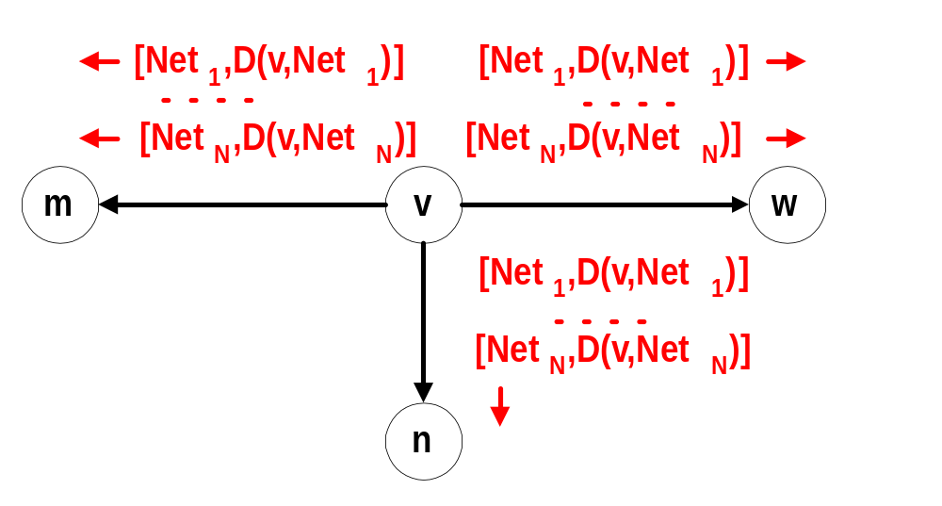
Distance Vector Algorithm: Sending Updates
Periodically, each node v sends the content of its routing table to its neighbors:

Slide 52
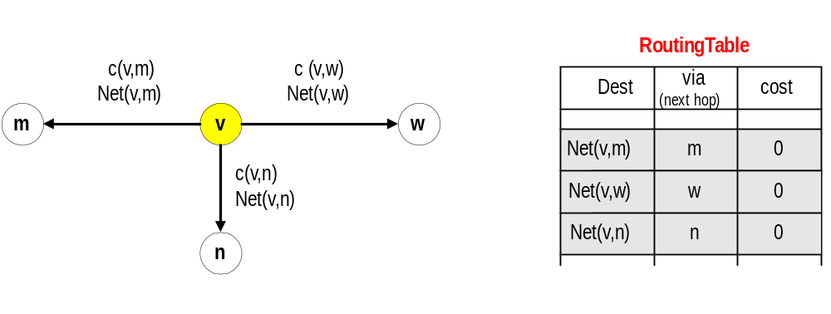
Initiating Routing Table I
Suppose a new node v becomes active.
The cost to access directly connected networks is zero:
      D (v, Net(v,m)) = 0
      D (v, Net(v,w)) = 0
      D (v, Net(v,n)) = 0

Slide 53
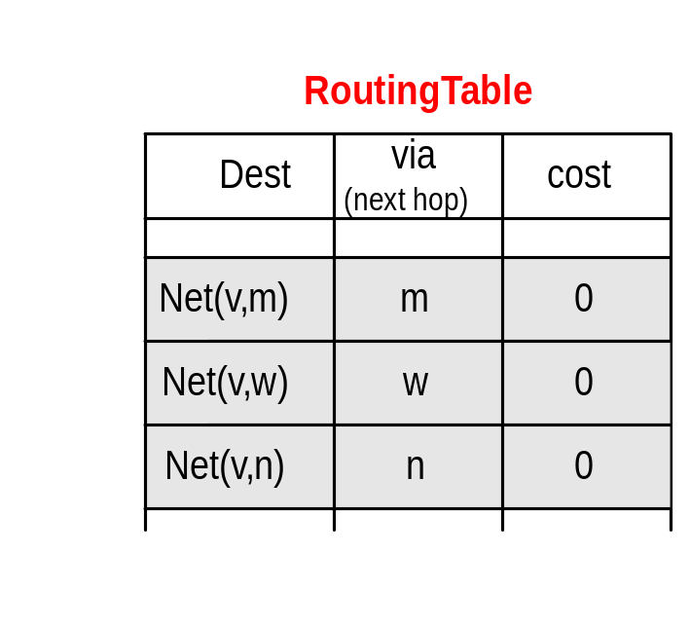
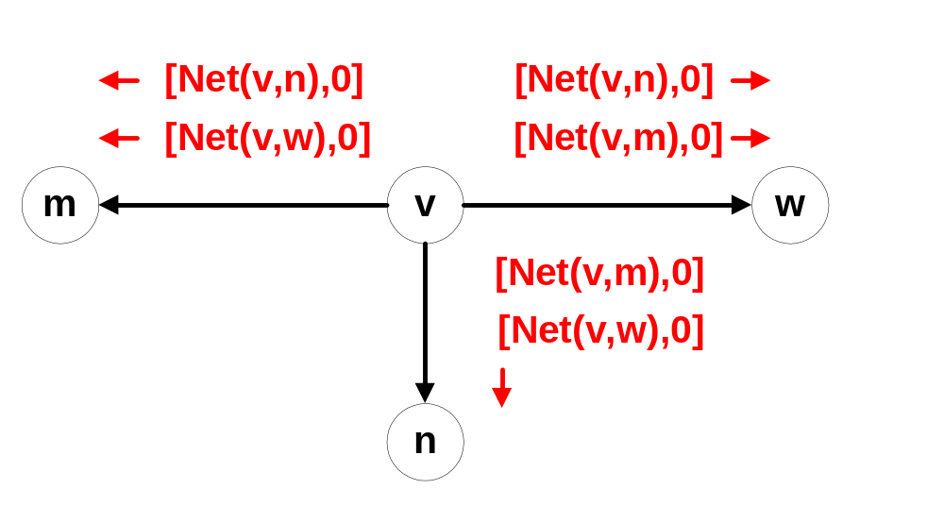
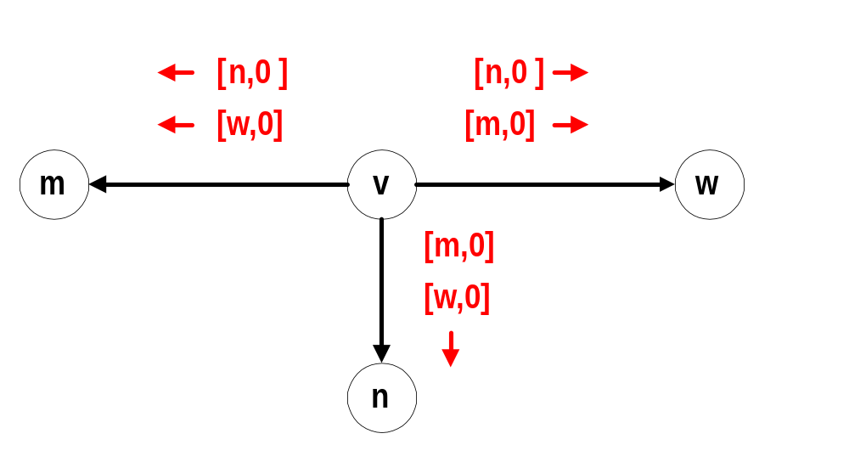
Initiating Routing Table II
New node v sends the routing table entry to all its neighbors:

Slide 54
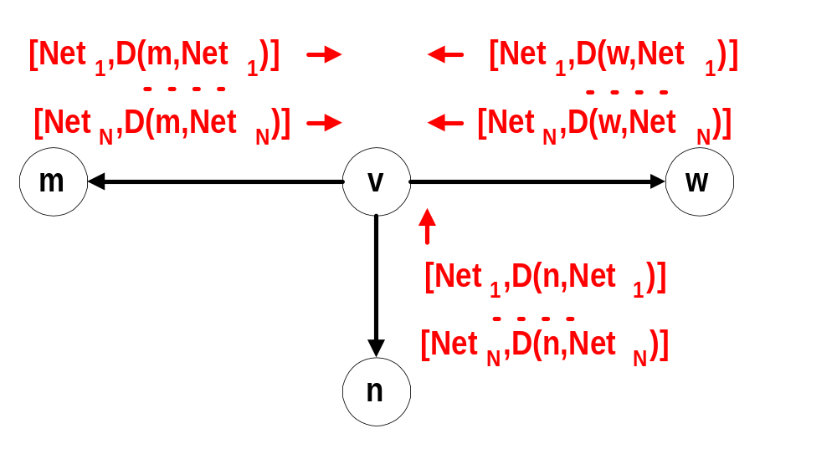
Initiating Routing Table III
Node v receives the routing tables from other nodes and builds up its routing table

Slide 55
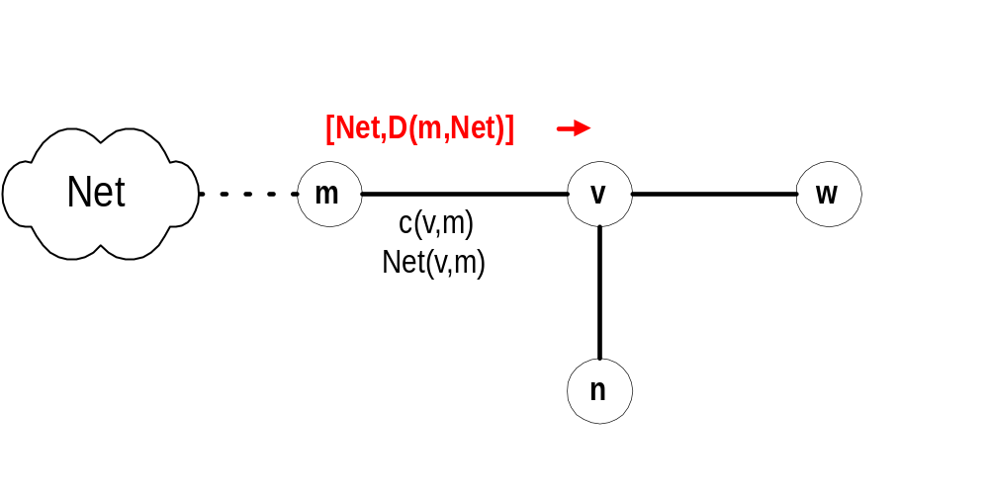
Updating Routing Tables I
Suppose node v receives a message from node m: [Net,D(m,Net)]
Node v updates its routing table and sends out further messages if the message reduces the cost of a route:
if ( D(m,Net) + c (v,m) < D (v,Net) ) {
  D^{new} (v,Net) := D (m,Net) + c (v,m);
  Update routing table;
  send message [Net, D^{new} (v,Net)] to all neighbors
}

Slide 56
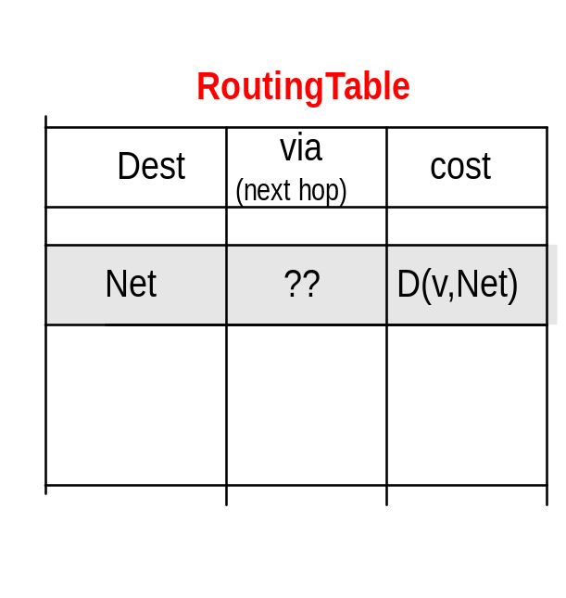
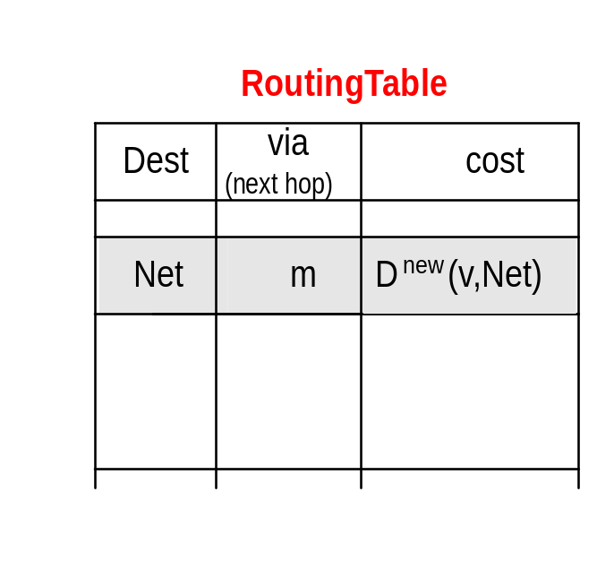
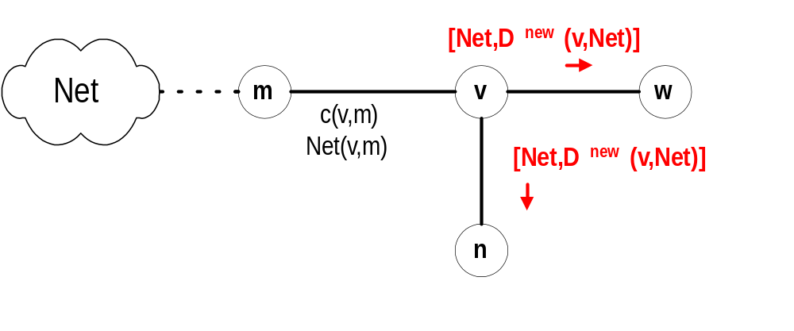
Updating Routing Tables II
Before receiving the message:
Suppose D (m,Net) + c (v,m) < D (v,Net):

Slide 57

Example
Assume: - link cost is 1, i.e., c(v,w) = 1
- all updates, updates occur simultaneously
- Initially, each router only knows the cost of connected interfaces
10.0.1.0/24
10.0.2.0/24
10.0.3.0/24
10.0.4.0/24
10.0.5.0/24
.2
.1
.2
.1
.2
.1
.2
.1
Router A
Router B
Router C
Router D
Net via
cost
Net via
cost
Net via
cost
Net via
cost
t=0:
10.0.1.0 - 0
10.0.2.0 - 0
t=0:
10.0.2.0 - 0
10.0.3.0 - 0
t=0:
10.0.3.0 - 0
10.0.4.0 - 0
t=0:
10.0.4.0 - 0
10.0.5.0 - 0
t=1:
10.0.1.0 - 0
10.0.2.0 - 0 10.0.3.0 10.0.2.2 1
t=1:
10.0.1.0 10.0.2.1 1
10.0.2.0 - 0
10.0.3.0 - 0
10.0.4.0 10.0.3.2 1
t=1:
10.0.2.0 10.0.3.1 1
10.0.3.0 - 0
10.0.4.0 - 0
10.0.5.0 10.0.4.2 1
t=1:
10.0.3.0 10.0.4.1 1
10.0.4.0 - 0
10.0.5.0 - 0
t=2:
10.0.1.0 - 0
10.0.2.0 - 0 10.0.3.0 10.0.2.2 1
10.0.4.0 10.0.2.2 2
t=2:
10.0.1.0 10.0.2.1 1
10.0.2.0 - 0
10.0.3.0 - 0
10.0.4.0 10.0.3.2 1
10.0.5.0 10.0.3.2 2
t=2:
10.0.1.0 10.0.3.1 2
10.0.2.0 10.0.3.1 1
10.0.3.0 - 0
10.0.4.0 - 0
10.0.5.0 10.0.4.2 1
t=2:
10.0.2.0 10.0.4.1 2
10.0.3.0 10.0.4.1 1
10.0.4.0 - 0
10.0.5.0 - 0

Slide 58
Example
10.0.1.0/24
10.0.2.0/24
10.0.3.0/24
10.0.4.0/24
10.0.5.0/24
.2
.1
.2
.1
.2
.1
.2
.1
Router A
Router B
Router C
Router D
Net via
cost
Net via
cost
Net via
cost
Net via
cost
t=2:
10.0.1.0 - 0
10.0.2.0 - 0 10.0.3.0 10.0.2.2 1
10.0.4.0 10.0.2.2 2
t=2:
10.0.1.0 10.0.2.1 1
10.0.2.0 - 0
10.0.3.0 - 0
10.0.4.0 10.0.3.2 1
10.0.5.0 10.0.3.2 2
t=2:
10.0.1.0 10.0.3.1 2
10.0.2.0 10.0.3.1 1
10.0.3.0 - 0
10.0.4.0 - 0
10.0.5.0 10.0.4.2 1
t=2:
10.0.2.0 10.0.4.1 2
10.0.3.0 10.0.4.1 1
10.0.4.0 - 0
10.0.5.0 - 0
t=3:
10.0.1.0 - 0
10.0.2.0 - 0 10.0.3.0 10.0.2.2 1
10.0.4.0 10.0.2.2 2
10.0.5.0 10.0.2.2 3
t=3:
10.0.1.0 10.0.2.1 1
10.0.2.0 - 0
10.0.3.0 - 0
10.0.4.0 10.0.3.2 1
10.0.5.0 10.0.3.2 2
t=3:
10.0.1.0 10.0.3.1 2
10.0.2.0 10.0.3.1 1
10.0.3.0 - 0
10.0.4.0 - 0
10.0.5.0 10.0.4.2 1
t=3:
10.0.1.0 10.0.4.1 3
10.0.2.0 10.0.4.1 2
10.0.3.0 10.0.4.1 1
10.0.4.0 - 0
10.0.5.0 - 0
Now, routing tables have converged !

Slide 59
Characteristics of Distance Vector Routing
Periodic Updates: Updates to the routing tables are sent at the end of a certain time period. A typical value is 90 seconds.
Triggered Updates: If a metric changes on a link, a router immediately sends out an update without waiting for the end of the update period.
Full Routing Table Update: Most distance vector routing protocols send their neighbors the entire routing table (not only entries which change).
Route invalidation timers: Routing table entries are invalid if they are not refreshed. A typical value is to invalidate an entry if no update is received after 3-6 update periods.

Slide 60
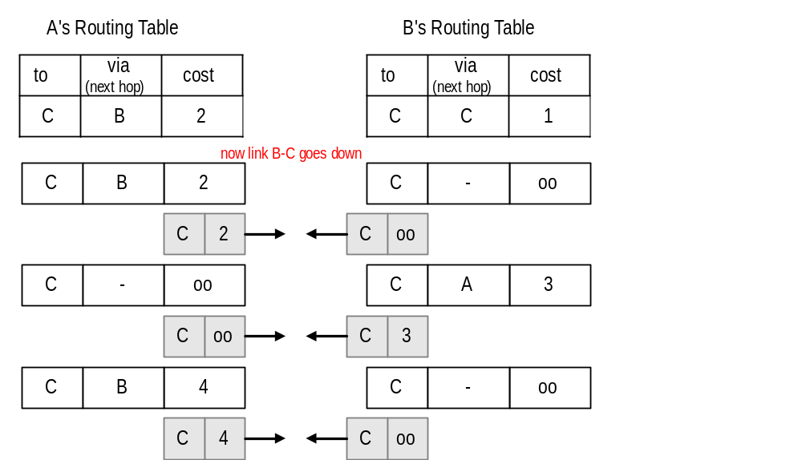
The Count-to-Infinity Problem
A
1
B
1
C

Slide 61
Count-to-Infinity
The reason for the count-to-infinity problem is that each node only has a “next-hop-view”
For example, in the first step, A did not advertise that its route (with cost 2) to C went through node B
How can the Count-to-Infinity problem be solved?

Slide 62
Count-to-Infinity
The reason for the count-to-infinity problem is that each node only has a “next-hop-view”
For example, in the first step, A did not realize that its route (with cost 2) to C went through node B
How can the Count-to-Infinity problem be solved?
Solution 1: Always advertise the entire path in an update message (Path vectors)
      If routing tables are large, the routing messages require substantial bandwidth
      BGP uses this solution

Slide 63
Count-to-Infinity
The reason for the count-to-infinity problem is that each node only has a “next-hop-view”
For example, in the first step, A did not realize that its route (with cost 2) to C went through node B
How can the Count-to-Infinity problem be solved?
Solution 2: Never advertise the cost to a neighbor if this neighbor is the next hop on the current path (Split Horizon)
      Example: A would not send the first routing update to B, since B is the next hop on A’s current route to C
      Split Horizon does not solve count-to-infinity in all cases!

Slide 64
RIP - Routing Information Protocol
A simple intradomain protocol
Straightforward implementation of Distance Vector Routing
Each router advertises its distance vector every 30 seconds (or whenever its routing table changes) to all of its neighbors
RIP always uses 1 as link metric
Maximum hop count is 15, with “16” equal to “∞”
Routes are timeout (set to 16) after 3 minutes if they are not updated

Slide 65
RIP - History
Late 1960s : Distance Vector protocols were used in the ARPANET
Mid-1970s: XNS (Xerox Network system) routing protocol is the precursor of RIP in IP (and Novell’s IPX RIP and Apple’s routing protocol)
1982 Release of routed for BSD Unix
1988 RIPv1 (RFC 1058)
- classful routing
1993 RIPv2 (RFC 1388)
- adds subnet masks with each route entry
- allows classless routing
1998 Current version of RIPv2 (RFC 2453)

Slide 66
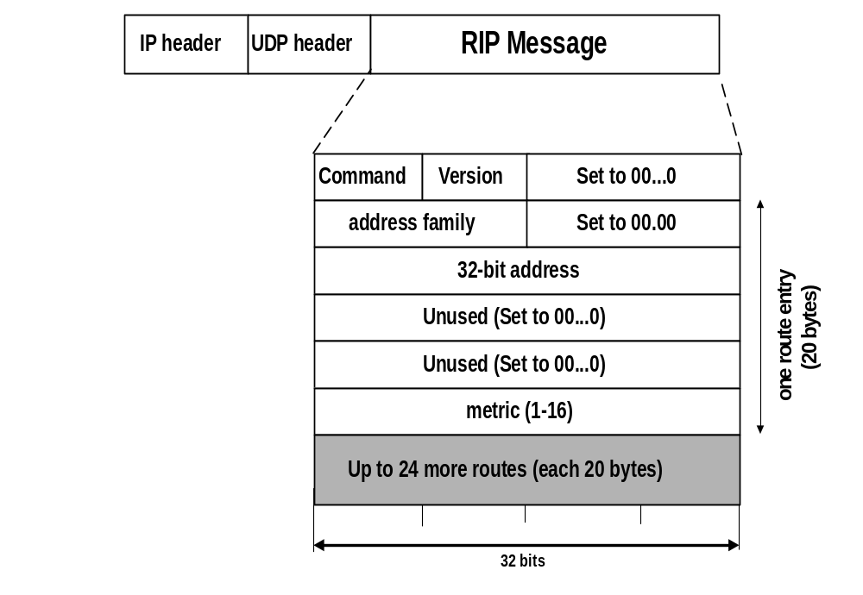
RIPv1 Packet Format
1: RIPv1
1: request
2: response
2: for IP
0…0: request full rou-ting table
Address of destination
Cost (measured in hops)
One RIP message can have up to 25 route entries

Slide 67
RIPv2
RIPv2 is an extends RIPv1:
  Subnet masks are carried in the route information
  Authentication of routing messages
  Route information carries better next-hop address if it exists
  Exploites IP multicasting
Extensions of RIPv2 are carried in unused fields of RIPv1 messages

Slide 68

RIPv2 Packet Format
2: RIPv2
1: request
2: response
2: for IP
0…0: request full rou-ting table
Address of destination
Cost (measured in hops)
One RIP message can have up to 25 route entries

Slide 69
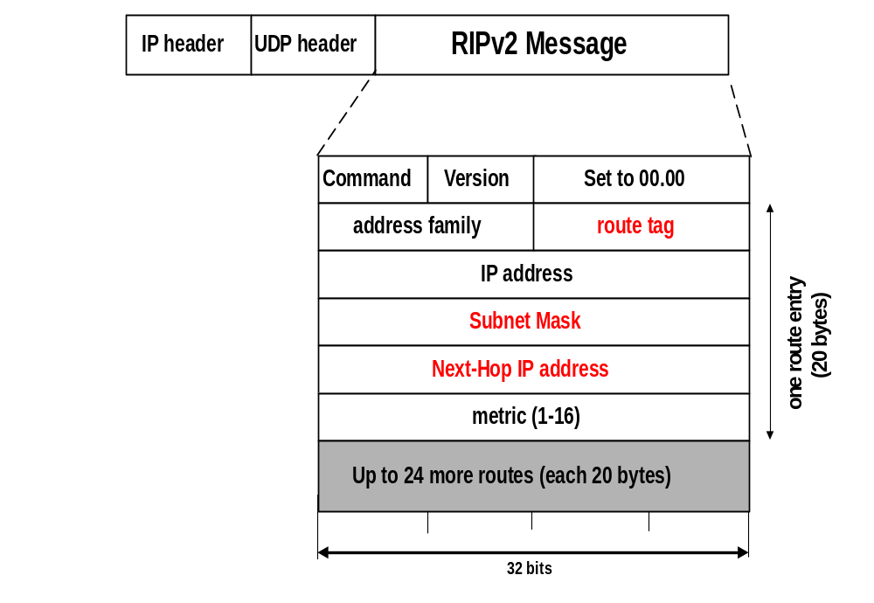
RIPv2 Packet Format
2: RIPv2
Used to carry information from other routing protocols (e.g., autonomous system number)
Subnet mask for IP address
Identifies a better next-hop address on the same subnet than the advertising router, if one exists (otherwise 0….0)

Slide 70
RIP Messages
This is the operation of RIP in routed. Dedicated port for RIP is UDP port 520.
Two types of messages:
  Request messages
    used to ask neighboring nodes for an update
  Response messages
    contains an update

Slide 71
Routing with RIP
Initialization: Send a request packet (command = 1, address family=0..0) on all interfaces:
    RIPv1 uses broadcast if possible,
    RIPv2 uses multicast address 224.0.0.9, if possible
requesting routing tables from neighboring routers
Request received: Routers that receive above request send their entire routing table
Response received: Update the routing table
Regular routing updates: Every 30 seconds, send all or part of the routing tables to every neighbor in an response message
Triggered Updates: Whenever the metric for a route change, send entire routing table.

Slide 72
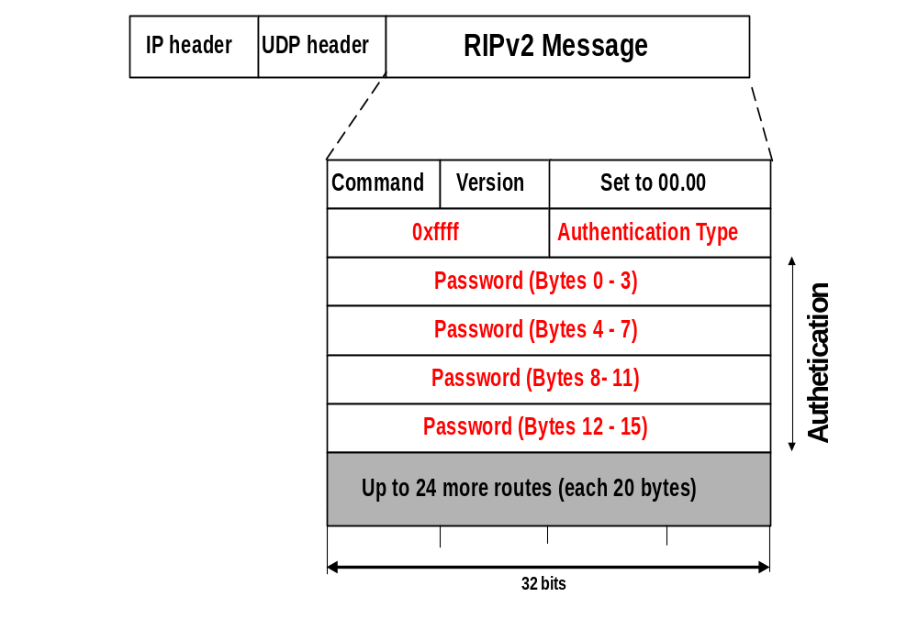
RIP Security
Issue: Sending bogus routing updates to a router
RIPv1: No protection
RIPv2: Simple authentication scheme
2: plaintext
password

Slide 73
RIP Problems
RIP takes a long time to stabilize
  Even for a small network, it takes several minutes until the routing tables have settled after a change
RIP has all the problems of distance vector algorithms, e.g., count-to-Infinity
        RIP uses split horizon to avoid count-to-infinity
The maximum path in RIP is 15 hops

Slide 74
Address Resolution Protocol
(ARP)

Slide 75
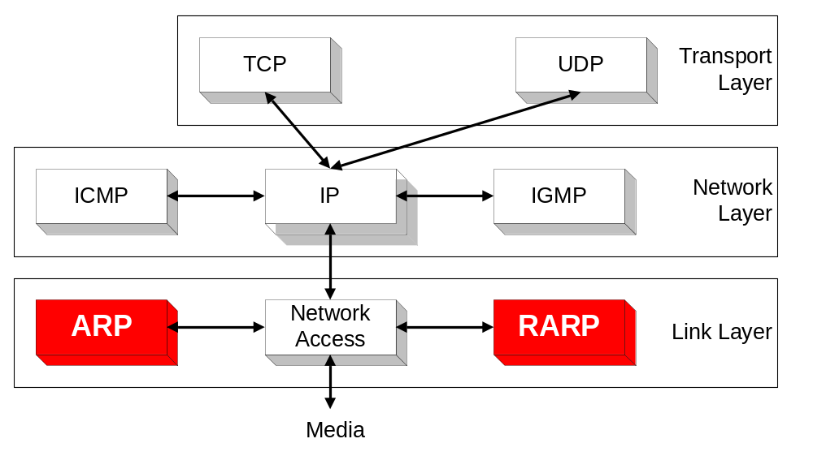
Overview

Slide 76
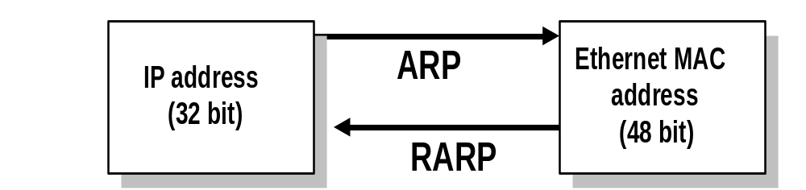
ARP and RARP
Note:
  The Internet is based on IP addresses
  Data link protocols (Ethernet, FDDI, ATM) may have different (MAC) addresses
The ARP and RARP protocols perform the translation between IP addresses and MAC layer addresses
We will discuss ARP for broadcast LANs, particularly Ethernet LANs

Slide 77
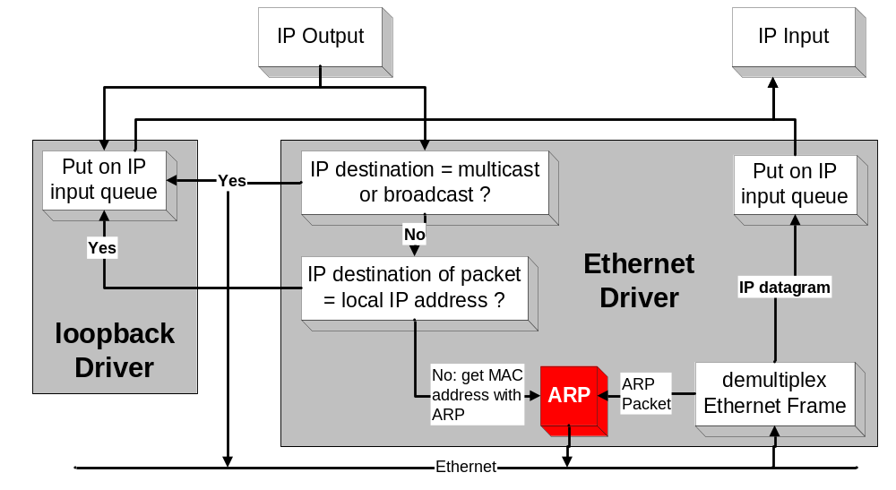
Processing of IP packets by network device drivers

Slide 78
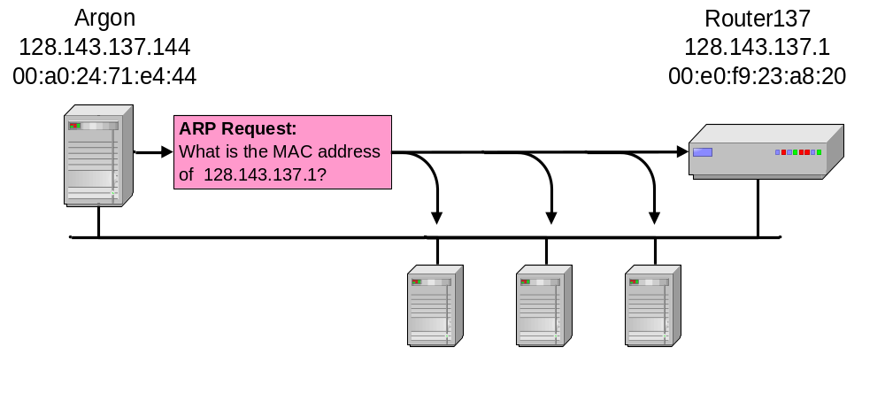
Address Translation with ARP
ARP Request:
Argon broadcasts an ARP request to all stations on the network: “What is the hardware address of Router137?”

Slide 79
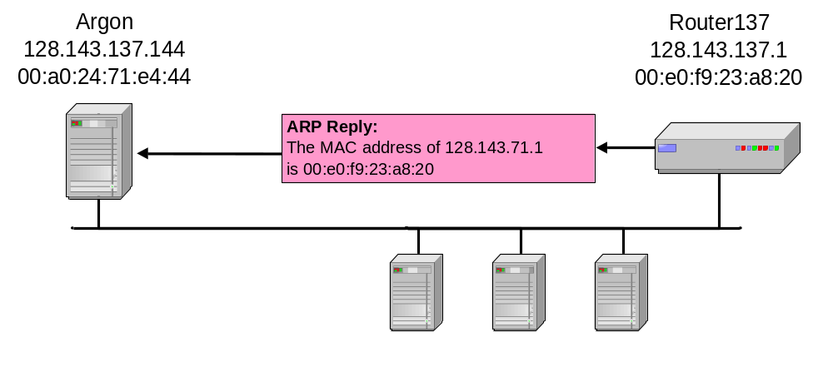
Address Translation with ARP
ARP Reply:
Router 137 responds with an ARP Reply which contains the hardware address

Slide 80
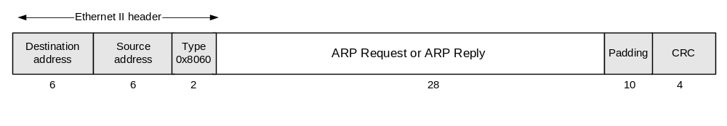
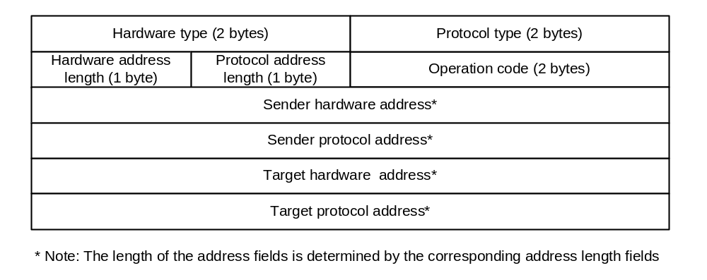
ARP Packet Format

Slide 81
Example
ARP Request from Argon:
Source hardware address: 00:a0:24:71:e4:44
Source protocol address: 128.143.137.144
Target hardware address: 00:00:00:00:00:00
Target protocol address: 128.143.137.1
ARP Reply from Router137:
Sender hardware address: 00:e0:f9:23:a8:20
Sender protocol address: 128.143.137.1
Target hardware address: 00:a0:24:71:e4:44
Target protocol address: 128.143.137.144

Slide 82
ARP Cache
Since sending an ARP request/reply for each IP datagram is inefficient, hosts maintain a cache (ARP Cache) of current entries. The entries expire after 20 minutes.
Contents of the ARP Cache:
  (128.143.71.37) at 00:10:4B:C5:D1:15 [ether] on eth0
  (128.143.71.36) at 00:B0:D0:E1:17:D5 [ether] on eth0
  (128.143.71.35) at 00:B0:D0:DE:70:E6 [ether] on eth0
  (128.143.136.90) at 00:05:3C:06:27:35 [ether] on eth1
  (128.143.71.34) at 00:B0:D0:E1:17:DB [ether] on eth0
  (128.143.71.33) at 00:B0:D0:E1:17:DF [ether] on eth0

Slide 83
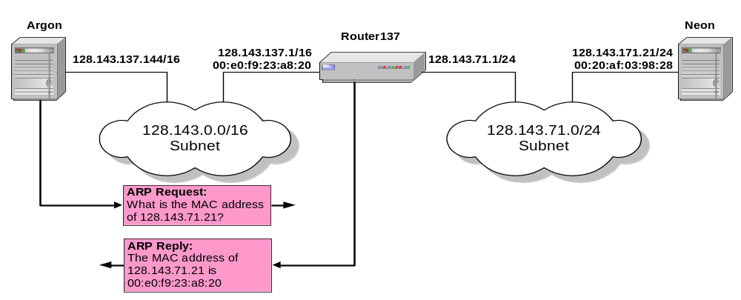
Proxy ARP
Proxy ARP: Host or router responds to ARP Request that arrives from one of its connected networks for a host that is on another of its connected networks.

Slide 84
Things to know about ARP
What happens if an ARP Request is made for a non-existing host?
Several ARP requests are made with increasing time intervals between requests. Eventually, ARP gives up.
On some systems (including Linux) a host periodically sends ARP Requests for all addresses listed in the ARP cache. This refreshes the ARP cache content, but also introduces traffic.
Gratuitous ARP Requests: A host sends an ARP request for its own IP address:
  Useful for detecting if an IP address has already been assigned.

Slide 85
Vulnerabilities of ARP
Since ARP does not authenticate requests or replies, ARP Requests and Replies can be forged
ARP is stateless: ARP Replies can be sent without a corresponding ARP Request
According to the ARP protocol specification, a node receiving an ARP packet (Request or Reply) must update its local ARP cache with the information in the source fields, if the receiving node already has an entry for the IP address of the source in its ARP cache. (This applies to ARP Request packets and to ARP Reply packets)
Typical exploitation of these vulnerabilities:
A forged ARP Request or Reply can be used to update the ARP cache of a remote system with a forged entry (ARP Poisoning)
This can be used to redirect IP traffic to other hosts

Slide 86
Internet Control Message Protocol (ICMP)

Slide 87
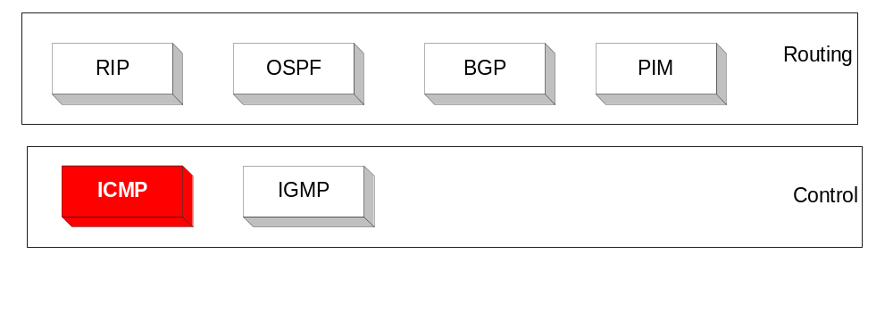
Overview
The IP (Internet Protocol) relies on several other protocols to perform necessary control and routing functions:
    Control functions (ICMP)
    Multicast signaling (IGMP)
    Setting up routing tables (RIP, OSPF, BGP, PIM, …)

Slide 88
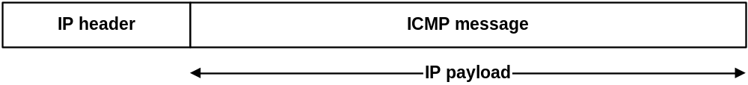
Overview
The Internet Control Message Protocol (ICMP) is a helper protocol that supports IP with facility for
  Error reporting
  Simple queries
ICMP messages are encapsulated as IP datagrams:

Slide 89
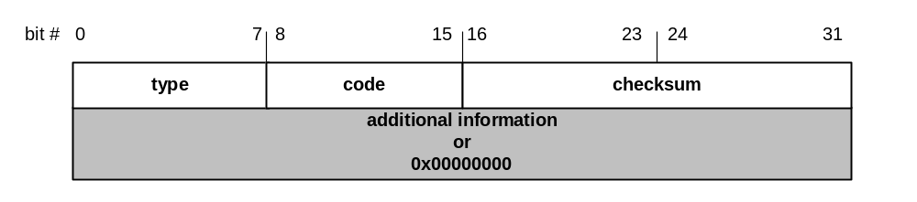
ICMP message format
4 byte header:
Type (1 byte): type of ICMP message
Code (1 byte): subtype of ICMP message
Checksum (2 bytes): similar to IP header checksum. Checksum is calculated over entire ICMP message
If there is no additional data, there are 4 bytes set to zero.
→ each ICMP messages is at least 8 bytes long

Slide 90
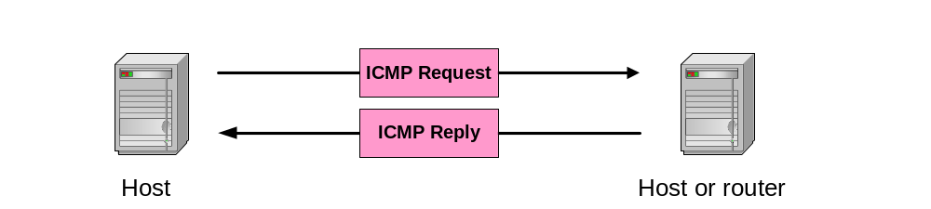
ICMP Query message
ICMP query:
Request sent by host to a router or host
Reply sent back to querying host

Slide 91
Example of ICMP Queries
Type/Code: Description
8/0 Echo Request
0/0 Echo Reply
13/0 Timestamp Request
14/0 Timestamp Reply
10/0 Router Solicitation
9/0 Router Advertisement
The ping command
uses Echo Request/
Echo Reply

Slide 92
Example of a Query:
Echo Request and Reply
Ping’s are handled directly by the kernel
Each Ping is translated into an ICMP Echo Request
The Ping’ed host responds with an ICMP Echo Reply
Host
or
Router
Host
or
router
ICMP ECHO REQUEST
ICMP ECHO REPLY

Slide 93
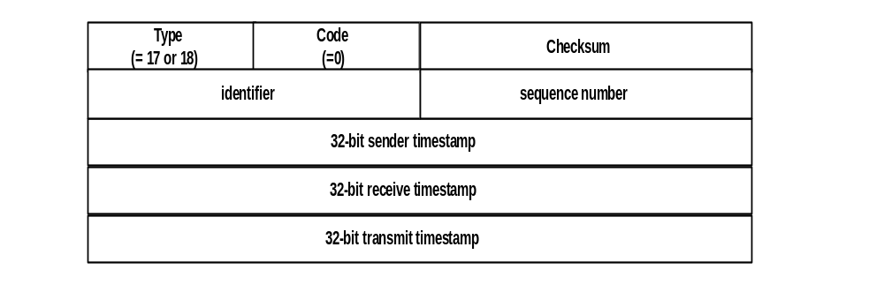
Example of a Query:
ICMP Timestamp
A system (host or router) asks another system for the current time.
Time is measured in milliseconds after midnight UTC (Universal Coordinated Time) of the current day
Sender sends a request, receiver responds with reply
Sender
Timestamp
Request
Receiver
Timestamp
Reply

Slide 94
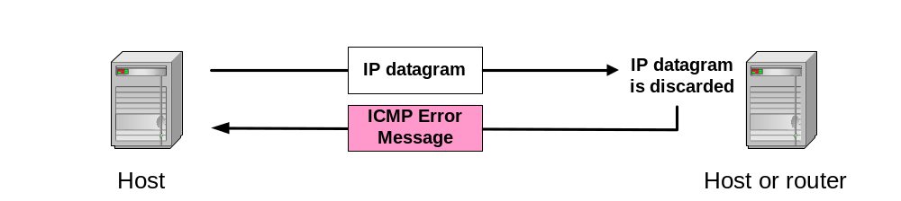
ICMP Error message
ICMP error messages report error conditions
Typically sent when a datagram is discarded
Error message is often passed from ICMP to the application program

Slide 95
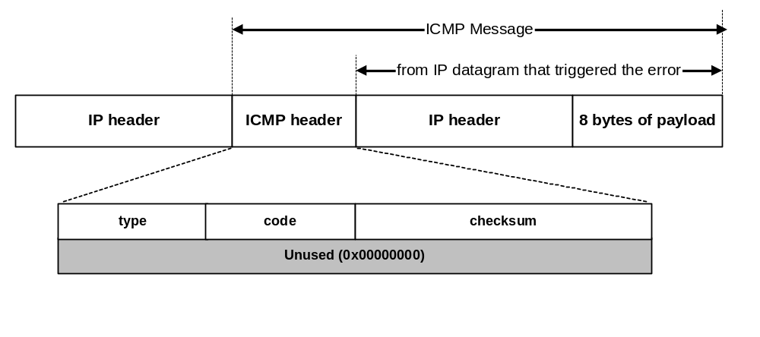
ICMP Error message
ICMP error messages include the complete IP header and the first 8 bytes of the payload (typically: UDP, TCP)

Slide 96
Frequent ICMP Error message
Type | Code | Description
3 | 0–15 | Destination unreachable | Notification that an IP datagram could not be forwarded and was dropped. The code field contains an explanation.
5 | 0–3 | Redirect | Informs about an alternative route for the datagram and should result in a routing table update. The code field explains the reason for the route change.
11 | 0, 1 | Time exceeded | Sent when the TTL field has reached zero (Code 0) or when there is a timeout for the reassembly of segments (Code 1)
12 | 0, 1 | Parameter problem | Sent when the IP header is invalid (Code 0) or when an IP header option is missing (Code 1)

Slide 97
Some subtypes of the “Destination Unreachable”
Code | Description | Reason for Sending
0 | Network Unreachable | No routing table entry is available for the destination network.
1 | Host Unreachable | Destination host should be directly reachable, but does not respond to ARP Requests.
2 | Protocol Unreachable | The protocol in the protocol field of the IP header is not supported at the destination.
3 | Port Unreachable | The transport protocol at the destination host cannot pass the datagram to an application.
4 | Fragmentation Needed and DF Bit Set | IP datagram must be fragmented, but the DF bit in the IP header is set.

Slide 98
Example: ICMP Port Unreachable
RFC 792: If, in the destination host, the IP module cannot deliver the datagram because the indicated protocol module or process port is not active, the destination host may send a destination unreachable message to the source host.
Scenario:
Request a service
at a port 80
Client
Server
No process is waiting at port 80
Port
Unreachable

Slide 99
Dynamic Routing Protocols II
OSPF

Slide 100

Distance Vector vs. Link State Routing
With distance vector routing, each node has information only about the next hop:
    Node A: to reach F go to B
    Node B: to reach F go to D
    Node D: to reach F go to E
    Node E: go directly to F
Distance vector routing makes
poor routing decisions if
directions are not completely
correct
(e.g., because a node is down).
If parts of the directions incorrect, the routing may be incorrect until the routing algorithms has re-converged.
A
B
C
D
E
F

Slide 101
Distance Vector vs. Link State Routing
In link state routing, each node has a complete map of the topology
If a node fails, each
node can calculate
the new route
Difficulty: All nodes need to
have a consistent view of the
network
A
B
C
A
B
C
A
B
C
D
E
F
D
E
F
D
E
F
A
B
C
D
E
F
A
B
C
A
B
C
A
B
C
D
E
F
D
E
F
D
E
F

Slide 102
Link State Routing: Properties
Each node requires complete topology information
Link state information must be flooded to all nodes
Guaranteed to converge

Slide 103
Link State Routing: Basic princples
  1. Each router establishes a relationship (“adjacency”) with its neighbors
  2.Each router generates link state advertisements (LSAs) which are distributed to all routers
      LSA = (link id, state of the link, cost, neighbors of the link)
  3. Each router maintains a database of all received LSAs (topological database or link state database), which describes the network as a graph with weighted edges
  4. Each router uses its link state database to run a shortest path algorithm (Dijikstra’s algorithm) to produce the shortest path to each network

Slide 104
Operation of a Link State Routing protocol
IP Routing
Table
Received
LSAs
Link State
Database
Dijkstra’s
Algorithm
LSAs are flooded
to other interfaces

Slide 105
Dijkstra’s Shortest Path Algorithm for a Graph
Input: Graph (N,E) with
N the set of nodes and E the set of edges
d_{vw} link cost (d_{vw} = infinity if (v,w) ∉ E, d_{vv} = 0)
s source node.
Output: D_{n} cost of the least-cost path from node s to node n
M = {s};
for each n ∉ M
D_{n} = d_{sn};
while (M ≠ all nodes) do
Find w ∉ M for which D_{w} = min{D_{j} ; j ∉ M};
Add w to M;
for each n ∉ M
D_{n} = min_{w} [ D_{n}, D_{w} + d_{wn} ];
Update route;
enddo

Slide 106
OSPF
OSPF = Open Shortest Path First
The OSPF routing protocol is the most important link state routing protocol on the Internet
The complexity of OSPF is significant
History:
  1989: RFC 1131 OSPF Version 1
  1991: RFC1247 OSPF Version 2
  1994: RFC 1583 OSPF Version 2 (revised)
  1997: RFC 2178 OSPF Version 2 (revised)
  1998: RFC 2328 OSPF Version 2 (current version)

Slide 107
Features of OSPF
Provides authentication of routing messages
Enables load balancing by allowing traffic to be split evenly across routes with equal cost
Type-of-Service routing allows to setup different routes dependent on the TOS field
Supports subnetting
Supports multicasting
Allows hierarchical routing

Slide 108
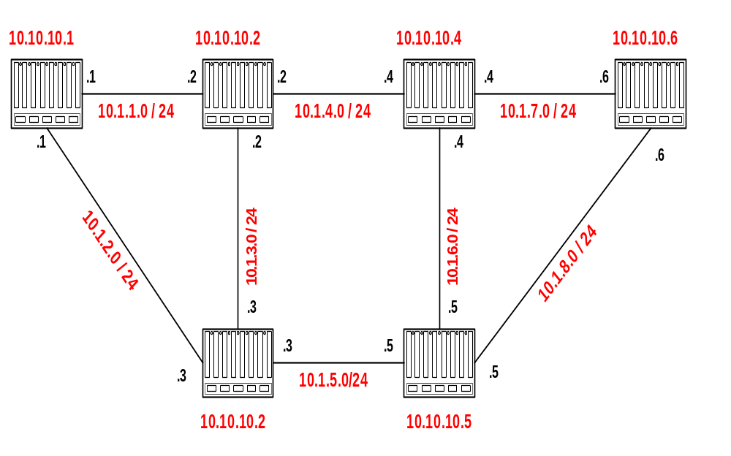
Example Network
4
2
1
Router IDs are selected independent of interface addresses
3
2
3
1
5
Link costs are called Metric
Metric is in the range [0 , 2¹⁶]
Metric can be asymmetric

Slide 109

Link State Advertisement (LSA)
4
The LSA of router 10.10.10.1 is as
follows:
Link State ID: 10.10.10.1 = can be Router ID
Advertising Router: 10.10.10.1 = Router ID
Number of links: 3 = 2 links plus router itself
Description of Link 1: Link ID = 10.1.1.1, Metric = 4
Description of Link 2: Link ID = 10.1.2.1, Metric = 3
Description of Link 3: Link ID = 10.10.10.1, Metric = 0
3
2
Each router sends its LSA to all routers in the network
(using a method called reliable flooding)

Slide 110
Network and Link State Database
Each router has a database which contains the LSAs from all other routers

Slide 111
Link State Database
The collection of all LSAs is called the link-state database
Each router has and identical link-state database
      Useful for debugging: Each router has a complete description of the network
If neighboring routers discover each other for the first time, they will exchange their link-state databases
The link-state databases are synchronized using reliable flooding

Slide 112
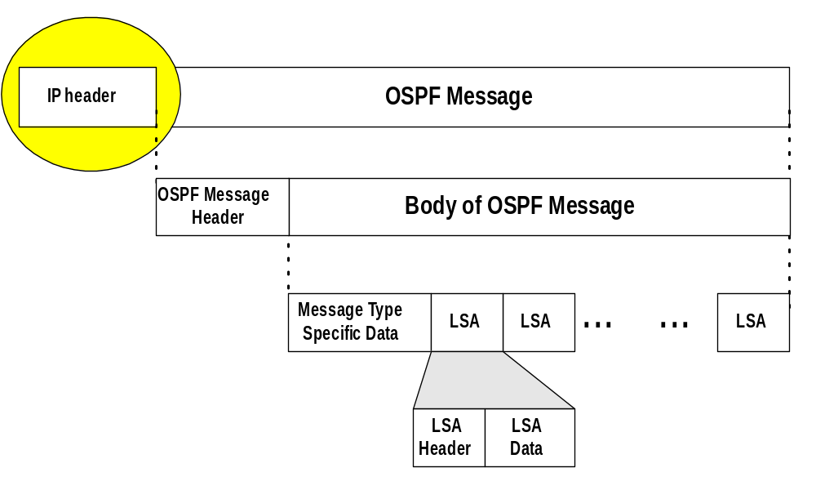
OSPF Packet Format
OSPF packets are not carried as UDP payload!
OSPF has its own IP protocol number: 89
TTL: set to 1 (in most cases)
Destination IP: neighbor’s IP address or 224.0.0.5 (ALLSPFRouters) or 224.0.0.6 (AllDRouters)

Slide 113
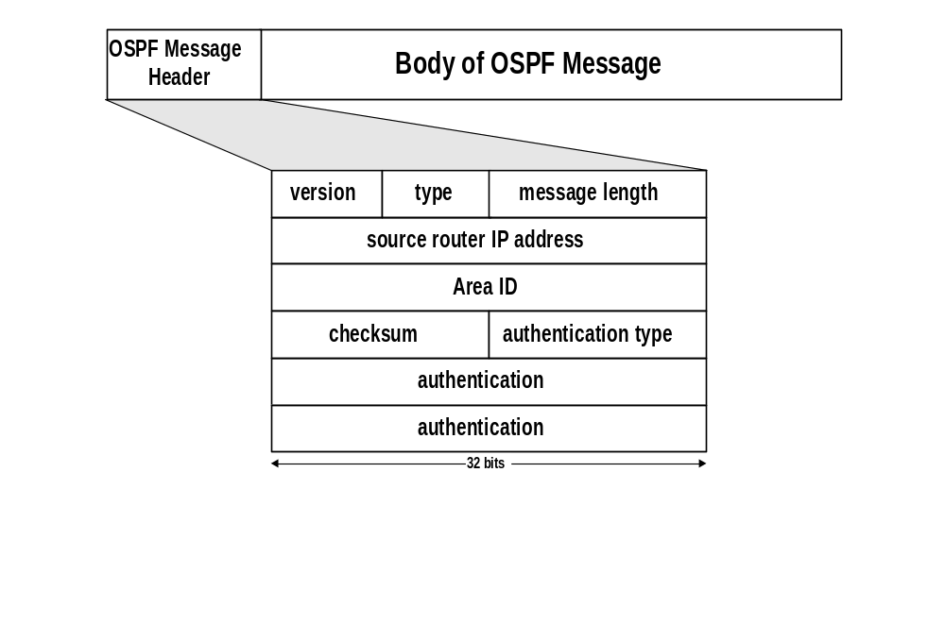
OSPF Packet Format
2: current version is OSPF V2
ID of the Area from which the packet originated
Message types:
1: Hello (tests reachability)
2: Database description
3: Link Status request
4: Link state update
5: Link state acknowledgement
0: no authentication
1: Cleartext password
2: MD5 checksum
(added to end packet)
Standard IP checksum taken over entire packet
Authentication passwd = 1: 64 cleartext password
Authentication passwd = 2: 0x0000 (16 bits)
KeyID (8 bits)
Length of MD5 checksum (8 bits)
Nondecreasing sequence number (32 bits)
Prevents replay attacks

Slide 114



OSPF LSA Format
LSA Header
Link 1
Link 2

Slide 115

Discovery of Neighbors
Routers multicasts OSPF Hello packets on all OSPF-enabled interfaces.
If two routers share a link, they can become neighbors, and establish an adjacency
After becoming a neighbor, routers exchange their link state databases
Scenario:
Router 10.1.10.2 restarts

Slide 116

Neighbor discovery and database synchronization
Scenario:
Router 10.1.10.2 restarts
Discovery of
adjacency
After neighbors are discovered the nodes exchange their databases
Sends database description.
(description only contains LSA headers)
Sends empty database description
Database description of 10.1.10.2
Acknowledges receipt of description

Slide 117

Regular LSA exchanges
10.1.10.2 explicitly requests each LSA from 10.1.10.1
10.1.10.1 sends requested LSAs
10.1.10.2 has more recent value for 10.0.1.6 and sends it to 10.1.10.1
(with higher sequence number)

Slide 118

Routing Data Distribution
LSA-Updates are distributed to all other routers via Reliable Flooding
Example: Flooding of LSA from 10.10.10.1
LSA
LSA
LSA
ACK
ACK
Update
database
Update
database
Update
database
ACK
LSA
ACK
ACK
ACK
ACK
LSA
LSA
LSA
LSA
LSA
ACK
ACK
LSA
ACK
Update
database
Update
database
ACK
ACK
ACK

Slide 119
Dissemination of LSA-Update
A router sends and refloods LSA-Updates, whenever the topology or link cost changes. (If a received LSA does not contain new information, the router will not flood the packet)
Exception: Infrequently (every 30 minutes), a router will flood LSAs even if there are no new changes.
Acknowledgements of LSA-updates:
    explicit ACK, or
    implicit via reception of an LSA-Update

Slide 120
Autonomous Systems
An autonomous system is a region of the Internet that is administered by a single entity.
Examples of autonomous regions are:
    UVA’s campus network
    MCI’s backbone network
    Regional Internet Service Provider
Routing is done differently within an autonomous system (intradomain routing) and between autonomous system (interdomain routing).

Slide 121
Autonomous Systems (AS)

Slide 122
BGP
BGP = Border Gateway Protocol
Currently in version 4
Note: In the context of BGP, a gateway is nothing else but an IP router that connects autonomous systems.
Interdomain routing protocol for routing between autonomous systems
Uses TCP to send routing messages
BGP is neither a link state, nor a distance vector protocol. Routing messages in BGP contain complete routes.
Network administrators can specify routing policies

Slide 123
BGP
BGP’s goal is to find any path (not an optimal one). Since the internals of the AS are never revealed, finding an optimal path is not feasible.
For each autonomous system (AS), BGP distinguishes:
    local traffic = traffic with source or destination in AS
    transit traffic = traffic that passes through the AS
    Stub AS = has connection to only one AS, only carry local traffic
    Multihomed AS = has connection to >1 AS, but does not carry transit traffic
    Transit AS = has connection to >1 AS and carries transit traffic

Slide 124

BGP

